Slide 1


Friday Training Hour
“AWS Frontend Basics”
Aka React / Redux / Amplify
Anthony McKale Principal Engineer
15/08/2021

Slide 2
AWS Frontend Basics
Today we’ll cover :
AWS Frontend Stack Overview
AWS Frontend Javascript : React / Redux
AWS Frontend Amplify Library
It’ll aim to cover
https://redux.js.org/tutorials/essentials/part-1-overview-concepts
https://docs.amplify.aws/start/q/integration/react

Slide 3
AWS Frontend Stack Overview

Slide 4
AWS Frontend Stack Overview
Amplify created about 2018 to simplify creating professional websites
Provides easy SSO login / user management
Easy Database access
Easy file asset management
Easy Frontend HTML / CSS via popular React library
https://aws.amazon.com/amplify/
https://en.wikipedia.org/wiki/Amazon_Web_Services

Slide 5
AWS Frontend Stack Overview
Amplify is built by smart people to be:
Secure
Supported / Supportable
Cheap / Serverless
Reliable
Easy*

Slide 6

AWS Frontend Stack Overview
https://aws.amazon.com/getting-started/fundamentals-core-concepts/

Slide 7
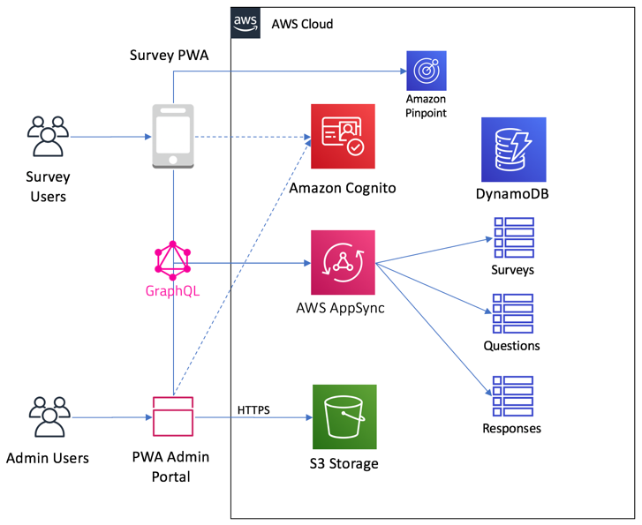
AWS Frontend Stack Diagram
Example Setup
Everything is best
Practise
Aka Gateway infront
of Lambdas
IAM tokens for all
Service access

Slide 8
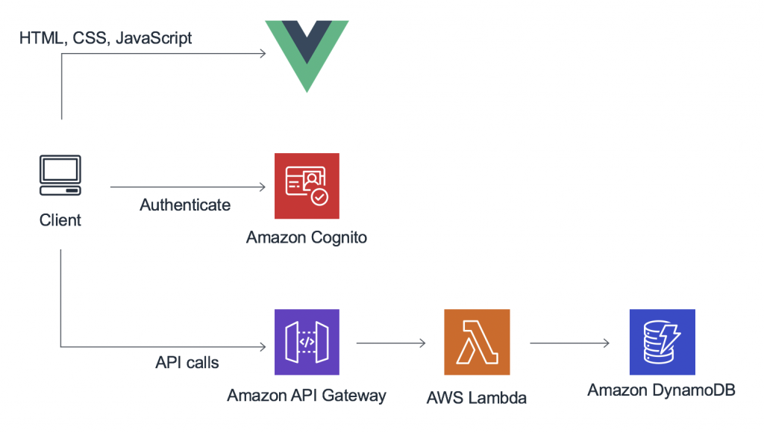
AWS Gateways: Amplify
Example 2: getting data from Gateway + Lambda instead of AppSync + GraphQL
https://aws.amazon.com/amplify
https://eu-west-2.console.aws.amazon.com/amplify/home

Slide 9
AWS Frontend Stack Overview
Amplify is built by smart people to be:
Secure
Supported / Supportable
Cheap / Serverless
Reliable
Easy*

Slide 10
Questions
AWS Amplify Overview?
Onto Stack Components….

Slide 11
AWS Amplify Stack Components

Slide 12
AWS Frontend Stack Overview
Overview:
Presentation (JS / HTML / CSS)
Serverless Authentication (via provided Libraries)
Serverless Data (via provided Libraries)
Persistent Monitoring

Slide 13
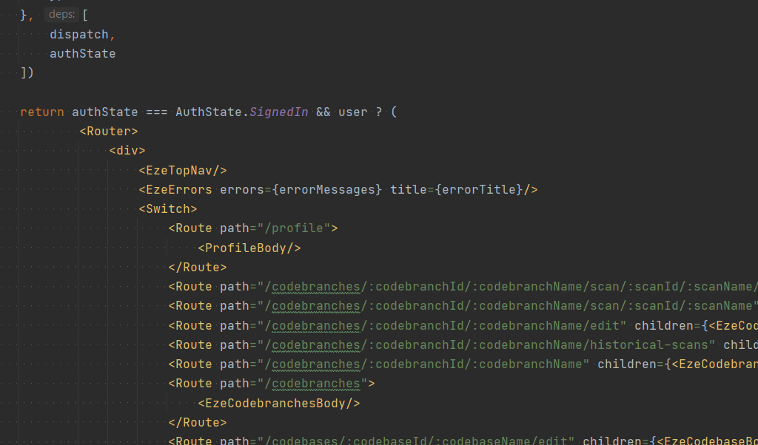
AWS Frontend Presentation
Presentation:
Frontend Coding =
JS React / Redux
CSS / SASS
Frontend Version Control =
CodeCommit (Git)
Build Systems
CodeBuild (CI)
Amplify Console (Wusiwug CI)

Slide 14
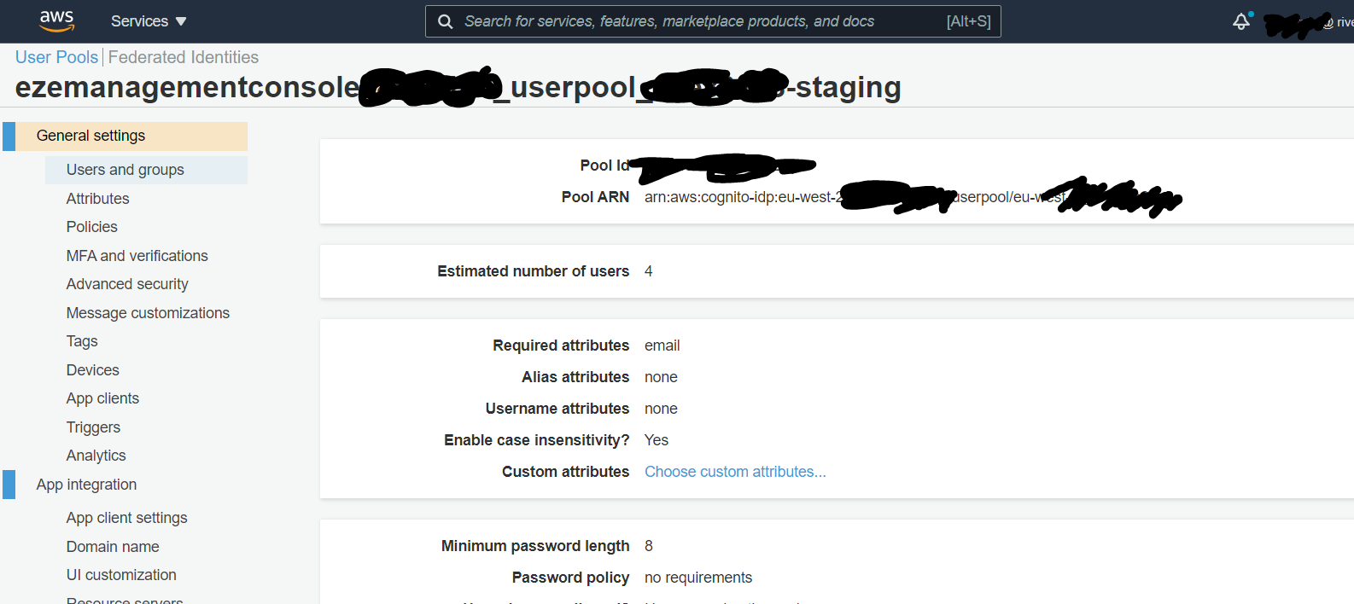
AWS Frontend Serverless Authentication
Authentication Services:
Login = Cognito + Lambda
API Access Tokens = Cognito
https://eu-west-2.console.aws.amazon.com/cognito/users/?region=eu-west-2

Slide 15
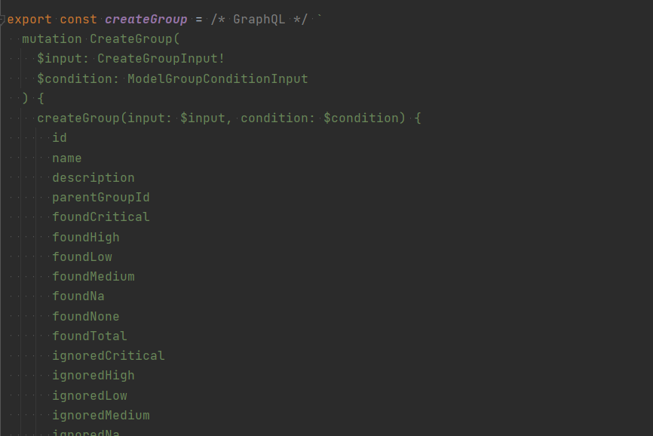
AWS Frontend Serverless Data
Data Services :
Static Files = s3
Query Data = (GraphQL) AppSync + DB
Dynamic API = (REST) API Gateway + Lambda

Slide 16
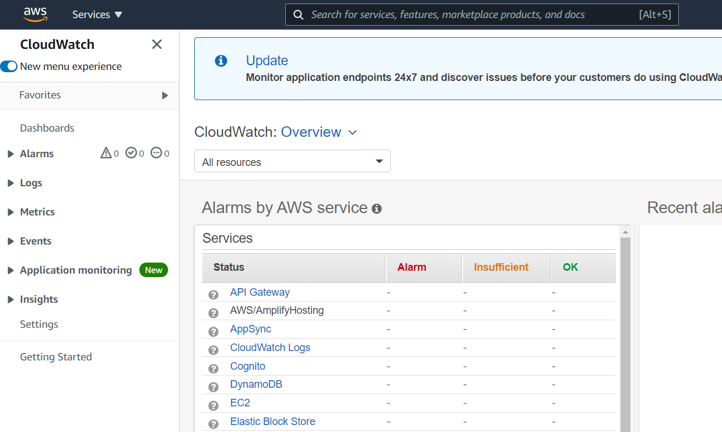
AWS Frontend Monitoring
Logging :
Monitoring: Cloudwatch
https://eu-west-2.console.aws.amazon.com/cloudwatch/home?region=eu-west-2#

Slide 17
Questions
AWS Amplify Stack ?
Onto react/redux

Slide 18
JS React / Redux

Slide 19
JS React / Redux
Amplify uses React / Redux for it’s JavaScript layer
This is where all the customisation / user code lives
Story of React…

Slide 20
JS React

Slide 21
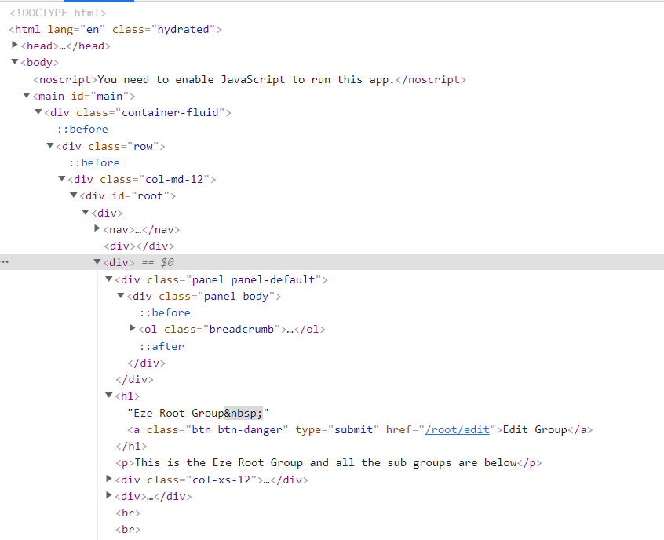
JS React: In my country there is problem
HTML is stored in a browser as DOM
Document Object Model
Which is a tree representation of the
HTML (which is just a subset of XML)

Slide 22
JS React: In my country there is problem
We used to update pages by updating individual DOM nodes

Slide 23
JS React: In my country there is problem
We used to update pages by updating individual DOM nodes
But …. writing to DOM is slow

Slide 24
JS React: In my country there is problem
We used to update pages by updating main DOM nodes
But …. writing large changes to DOM is slow
We tried to make it faster by reading DOM first and only editing what changed

Slide 25
JS React: In my country there is problem
We used to update pages by updating main DOM nodes
But …. writing large changes to DOM is slow
We tried to make it faster by reading DOM first and only editing what changed
But …. Reading large chunks of DOM is slow

Slide 26
JS React: In my country there is problem
We used to update pages by updating main DOM nodes
But …. writing large changes to DOM is slow
We tried to make it faster by reading DOM first and only editing what changed
But …. Reading large chunks of DOM is slow
React to the rescue (Virtual DOM)

Slide 27
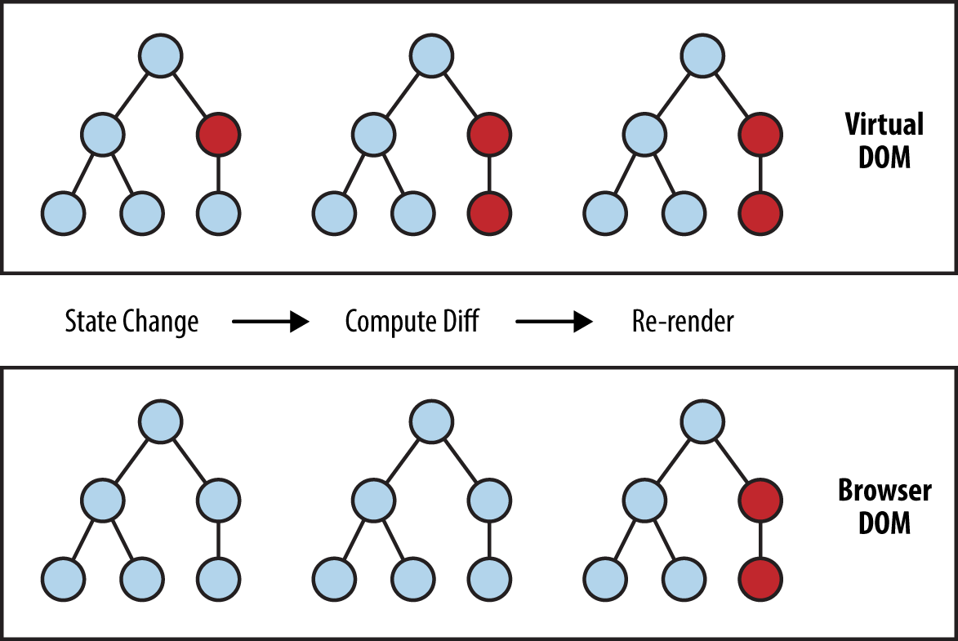
JS React: Virtual DOM
Because DOM is slow to read and write
React stores a copy of the DOM in
Memory
Any changes Reacts makes are diffed
Only required Changes are made

Slide 28
JS React: Virtual DOM
This is MUCH MUCH faster than native DOM
However that means :
React needs to edit all HTML
(NO random jquery plugins)
Javascript required for initial page
load

Slide 29
JS React: View / State = WebComponent
React isn’t just Virtual DOM, It’s a full templating system
- Taking state
- Inserting it’s into a template view
Updating it as state changes
Lastly, Nesting all the views as WebComponents

Slide 30
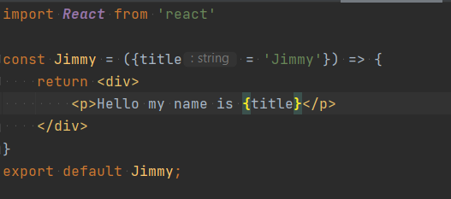
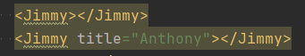
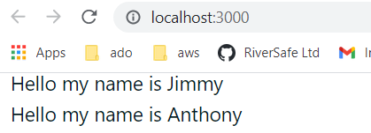
JS React: State
view being used (as a WebComponent)
state / view

Slide 31
JS React: Tutorial
React is huge, I’m only brushing the surface
https://reactjs.org/tutorial/tutorial.html

Slide 32
Questions
JS React ?
Onto redux

Slide 33
JS Redux

Slide 34
JS Redux
Like butter on bread
Like Rain in Scotland
React and Redux complete each other

Slide 35
JS Redux job in react
React commonly* uses redux in it’s core templating system
*small projects sometimes use inbuilt system but it’s a bit limited

Slide 36
JS Redux
React isn’t just Virtual DOM, It’s a full templating system
- Taking state (NORMALLY: GOT VIA REDUX)
- Inserting it’s into a template view
Updating it as state changes (NORMALLY: INFORMED VIA REDUX)
Lastly, Nesting all the views as WebComponents

Slide 37
JS Redux
What is redux, it’s a State management System
Made up of:
state: object representing data
store: It holds a global state
actions: events called on store
middleware : on action called on store, does sideeffects aka HTTP calls
reducers: on action called on store, changes store’s global state

Slide 38
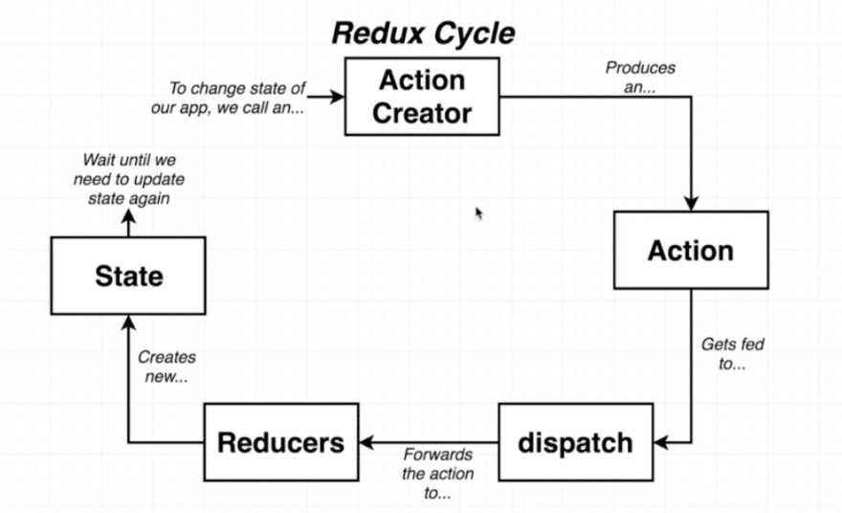
JS Redux
What is redux diagram
https://dev.to/bouhm/react-redux-flow-terminologies-and-example-104b

Slide 39
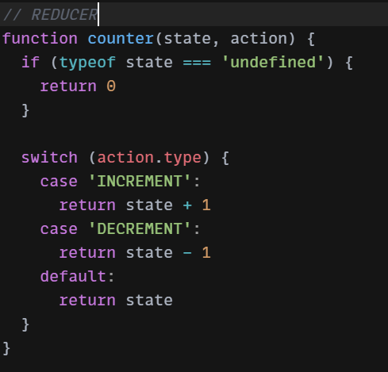
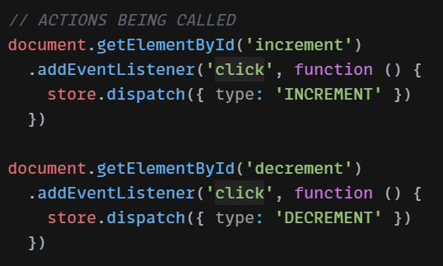
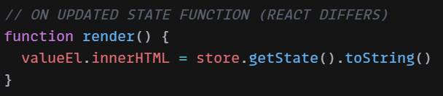
JS Redux Example
Increase a number example

Slide 40
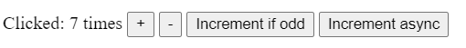
JS Redux Example
Increase a number example
https://redux.js.org/introduction/examples
https://codesandbox.io/s/github/reduxjs/redux/tree/master/examples/counter-vanilla

Slide 41
JS Redux: Tutorial
Redux is huge, I’m only brushing the surface
https://redux.js.org/tutorials/fundamentals/part-1-overview

Slide 42
Questions
JS Redux ?
Onto Amplify Libs (very briefly)

Slide 43
JS Amplify

Slide 44
JS Amplify
React Components for Login Screen
JS Libraries for accessing serverless resources
Also there’s a command line interface for editing serverless resources

Slide 45
JS Amplify: Tutorial
JS Amplify is huge, I’m only brushing the surface
https://docs.amplify.aws/lib/restapi/getting-started/q/platform/js

Slide 46
Questions
JS Amplify ?

Slide 47
Questions
I’ve been Anthony M^{c}Kale “Wizard without Portfolio” Fixer-Upper of Broken things, and creator of time-constrained workable Fudges for 21 years. Email : anthony@zapper.hodgers.com

Slide 48
Thank
you

